Slide 1
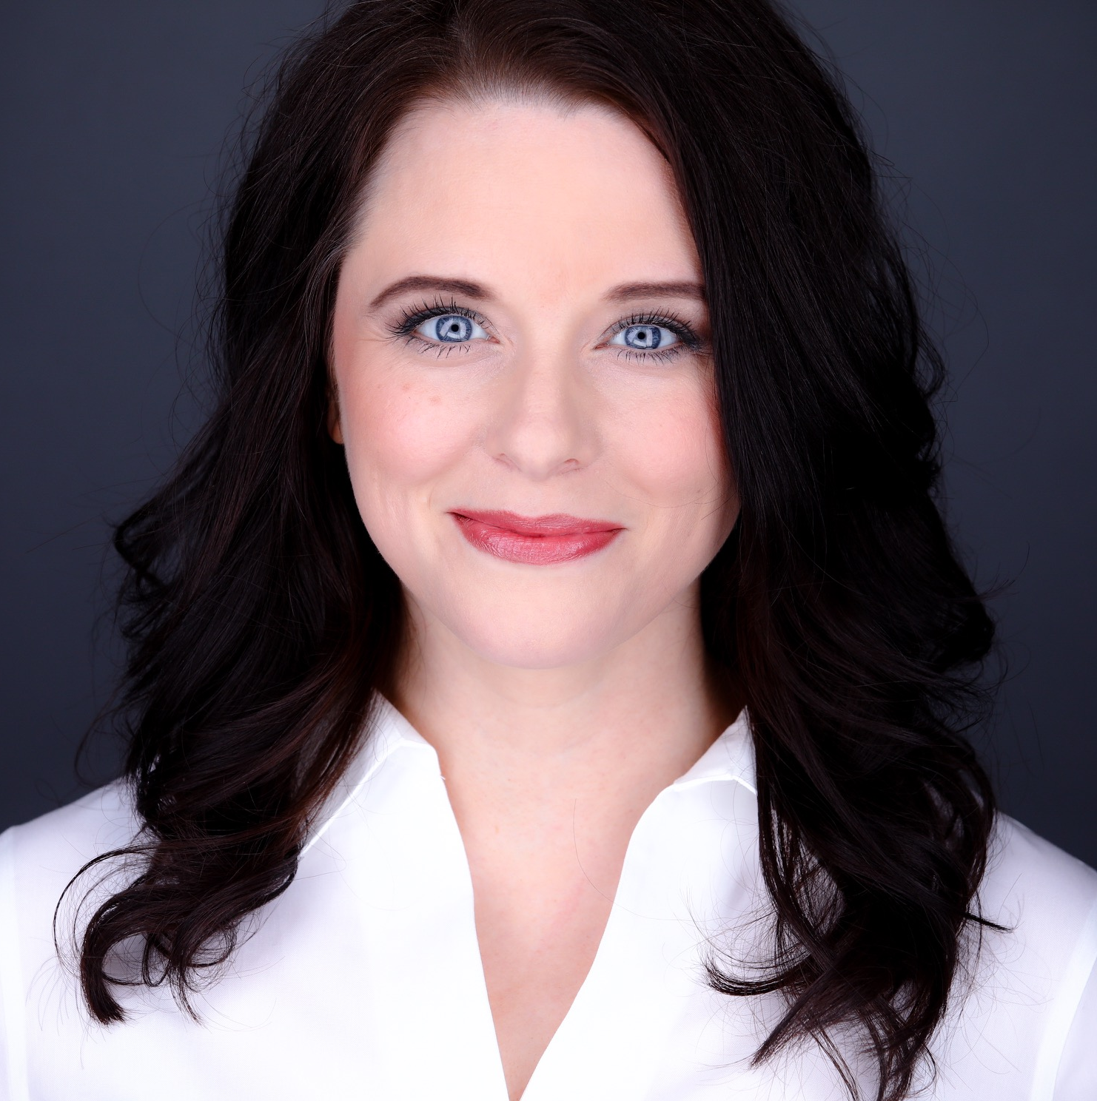
Nicole Di Bella Manager — Acceleration
Email
Nicole.DiBella@thebridge.com
Location
DFW, Texas
Mobile
(214) 449-6447
Nicole joined The Bridge in January 2024. She has spent 15+ years analyzing, developing and implementing operational improvements while increasing revenues by facilitating growth or decreasing costs by increasing efficiency. Nicole has led engagements and implementations impacting all aspects of the product life-cycle.
EXPERIENCE
Industry Experience
CPG| Technology | 3PL | Consulting | Digital Transformation | Supply Chain
CPG
Created model and negotiated a cost savings of over £200K in renewal of 3PL warehousing contract
ERP software selection and implementation. Designed the integration of all business processes including new product development, customer orders, supply chain and accounting to create a transparent business model. Created processes for global inventory visibility and accountability from item creation to customer shelf
Consulting
Performed a supply chain network cost and service scenario optimization for Wolverine. Decreased global network operating costs by 5% and increased service levels within 5-year planning horizon.
Conducted an operations assessment of an existing facility. Projected capacity requirements from demand and SKU profile data for Hugo Boss. Recommendation for warehouse reconfiguration for low velocity items increased storage capacity by 26%. Short-term operation recommendations lead to $.5M yearly labor savings.
Explored disruptive technology business value for Exxon, Unilever and Mars
3PL
Performed competitive analysis and a reverse logistic opportunity assessment. Developed a new B2C channel providing thousands of dollars of sales for previously unsalvageable goods
Completed research, vendor selection and business cases for innovative warehouse technologies
BACKGROUND
Education
BA - Boston University
MBA - Carnegie Mellon
Lean Six Sigma Greenbelt Qualified
Functional Skills
Production Operations, Quantitative Analysis, Organizational Behavior, Product Lifecycle Management, Finance, Network Optimization, Operations Assessment, Business Case, Supply Chain, Transition Management, Performance Improvement, Digital Transformation, Logistics, Forecasting, Vendor Management, Software Selection, Innovation

